Slide 1
DWR Quality Measurements Tuning and Calibration
S.Prayek
Prayek.sandepogu@imd.gov.in

Slide 2
Calibration
Accuracy
Consistency
Quality Control
Comparison and integration

Slide 3
Calibration
Weather radar Calibration
Transmitter
Tx calibration
Transmitted Power, Frequency, PW & OBW
VSWR
Receiver
Noise Figure
Front End Gain
IRR
MDS
Dynamic Range
Freq & Power at Test Points -1.f. Tx Channel -1.g. STALO -1.h. 2nd LO
Antenna
Sun Calibration

Slide 4
MEASUREMENT EQUIPMENTS USED
Spectrum Analyzer
Signal Generator
Power Meter with suitable Sensor
Attenuators
Oscilloscope
Crystal Detector
Multimeter
Cables, transitions and terminations, Cable Adaptors

Slide 5
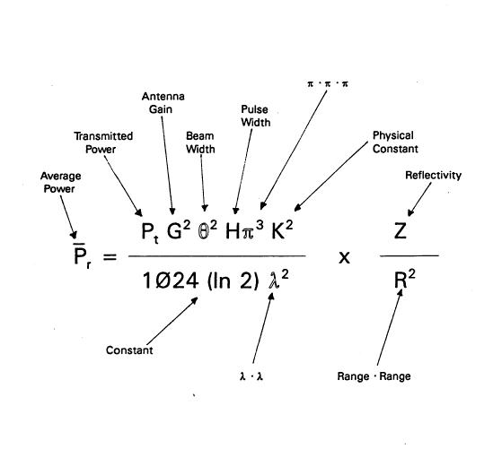
Tx Calibration
z = CP_{r}r²

Slide 6
POWER Measurement
Derive Peak Power from Avg Power Pp/Pa=PRT/PW = 10*log(1/PRF*PW) dB

Slide 7
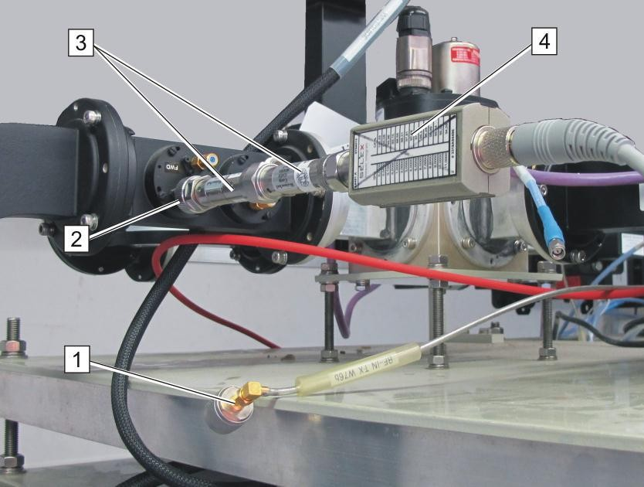
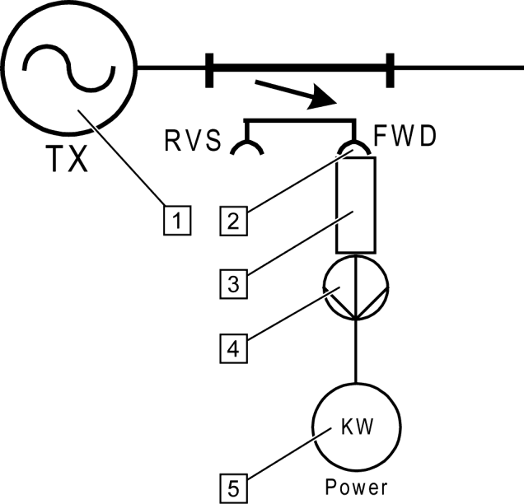
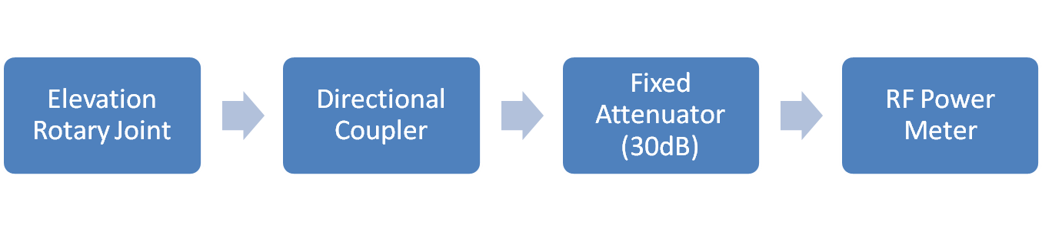
Power Measurement
Ppeak(dB)=Pavg(dB)+attn(dB)+coupler attn(dB)+duty cycle
Fod Portrwar

Slide 8
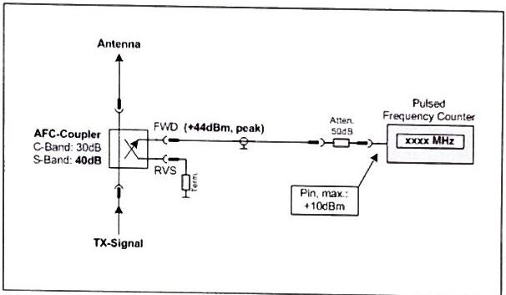
Transmitted Frequency

Slide 9
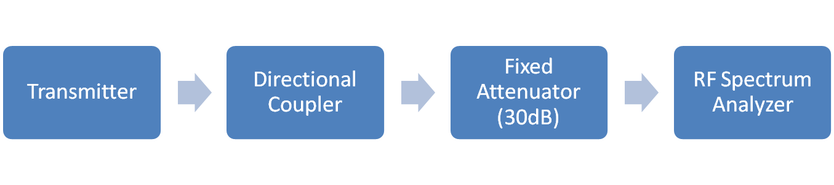
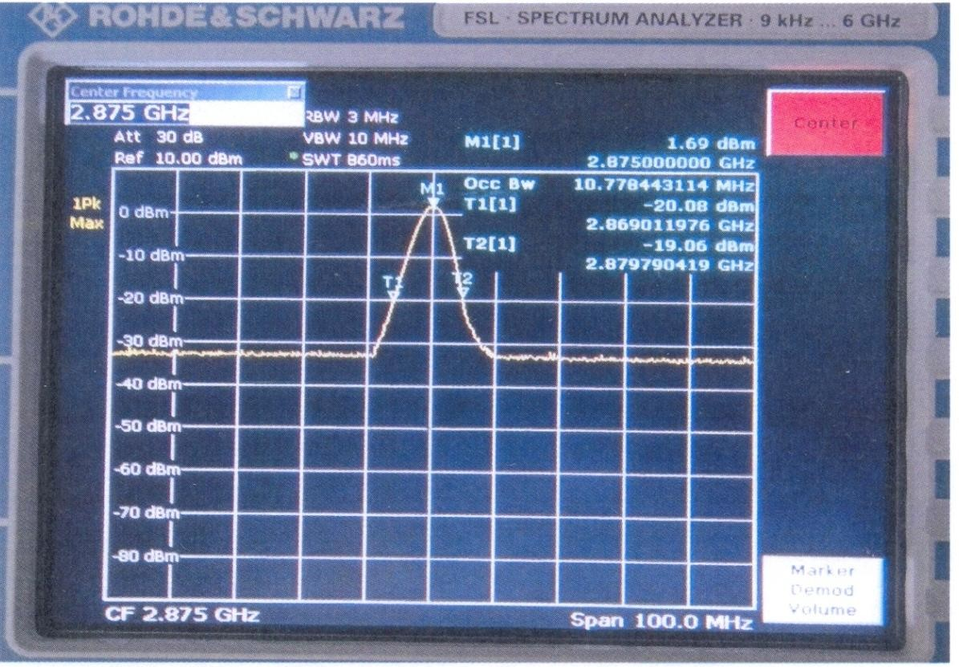
Frequency & OBW
Forwar
d Port

Slide 10
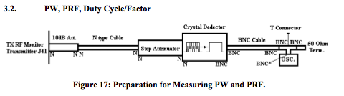
PRF, PW, Duty Factor measurement
This measurement is done by oscilloscope. Due the limited capability of the oscilloscope for measuring the high frequency, a step attenuator crystal detector and 50-Ω terminator must be used to measure the high frequency.

Slide 11
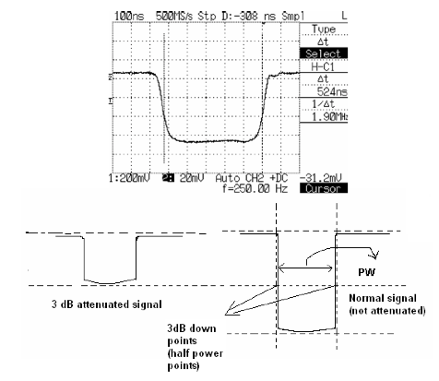
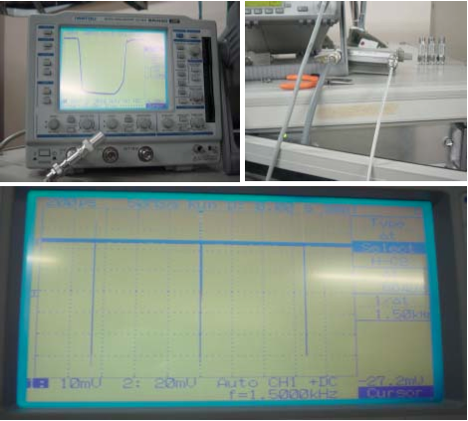
PRF, PW, Duty Factor measurement

Slide 12
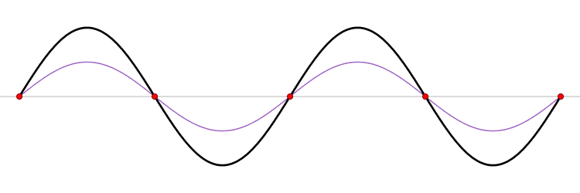
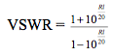
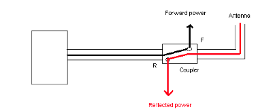
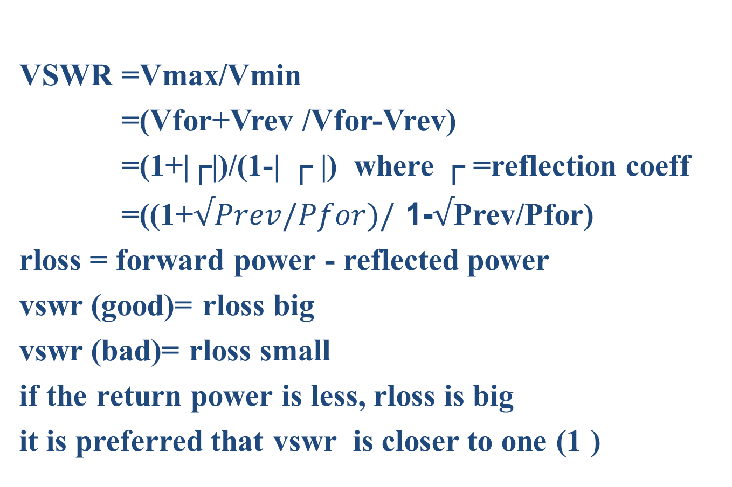
Voltage Standing Wave Ratio
VSWR =Vmax/Vmin
=(Vfor+Vrev /Vfor-Vrev)
=(1+|┌|)/(1-| ┌ |) where ┌ =reflection coeff
=((1+$√Prev/Pfor)/$ 1-$√$Prev/Pfor)
rloss = forward power - reflected power
vswr (good)= rloss big
vswr (bad)= rloss small
if the return power is less, rloss is big
it is preferred that vswr is closer to one (1 )
VSWR

Slide 13
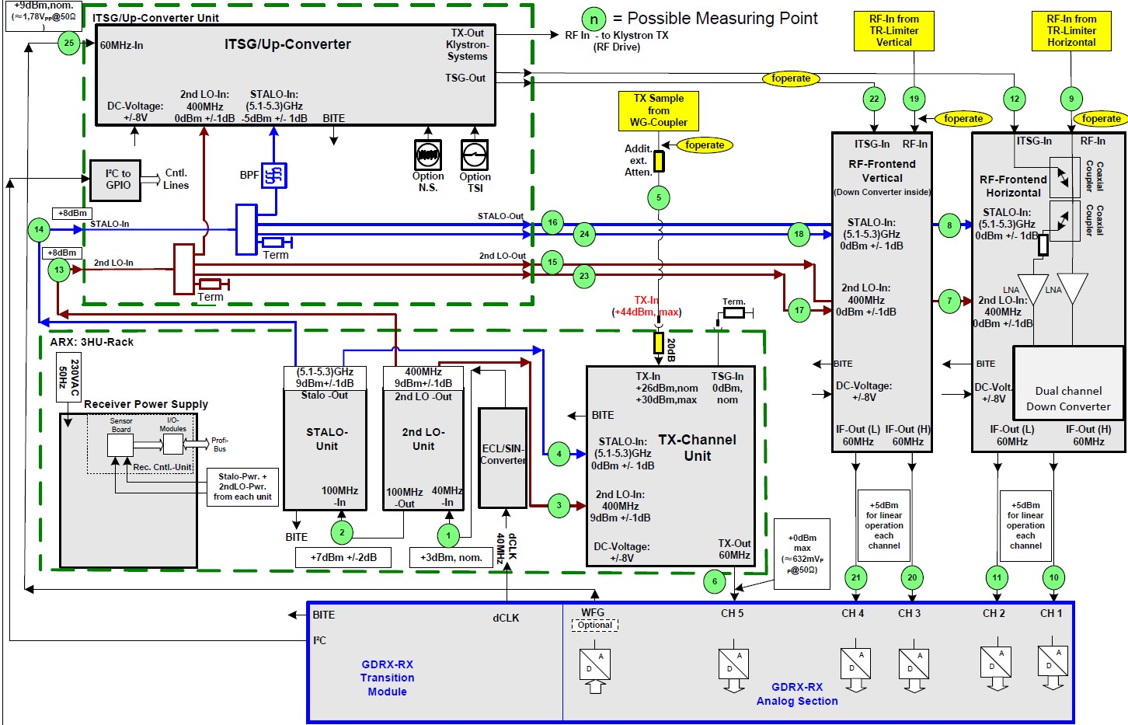
Receiver

Slide 14
Noise Figure
The "noise figure (NF)" or the related "noise factor (F)" is a number used to specify the performance of a radio receiver.
The lower the value of noise figure, the better the performance.
NF = 10 * log10 (F)
Methods for finding out Noise figure
Noise Figure Meter
gain method
Y factor method

Slide 15
Noise Figure – Y factor
If the known SNR noise figure analyzer is not available, a noise source whose ENR(Excess Noise ratio is known can be connected to a Spectrum analyser (Vector/Network), where the Y factor (Ratio of Power Measured with Noise Power ON to Ratio of Power with Noise Power Off) schema is utilized and can be calculated
ENR is a logarithmic scale that displays the ratio of hot (Th), and cold (Tc) noise temperature values for calculating noise figure. The scale range is arbitrary and based upon the selection of the lowest hot (Th) temperature chosen for the calculation.
ENR = (Th/Tc - 1); where Th > Tc (290°K);
Th = temperature hot; Tc = temperature cold
By selecting a temperature value close to 290°K, a large ENR log scale can be calculated.
References to Th of 290.290 to 290290°K. gives a logarithmic scale from -30 dB to +30 dB ENR.

Slide 16
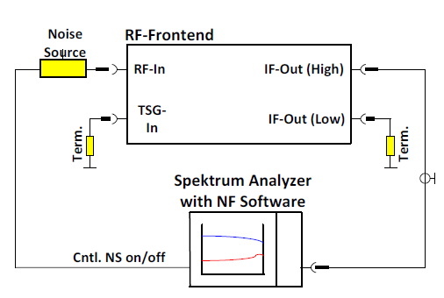
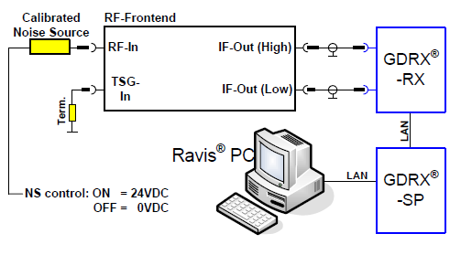
NF – Measurement procedure
NF(dB) = ENR(dB) – 10log (Y-1)
Y = Non/Noff , Non & Noff linear power values

Slide 17
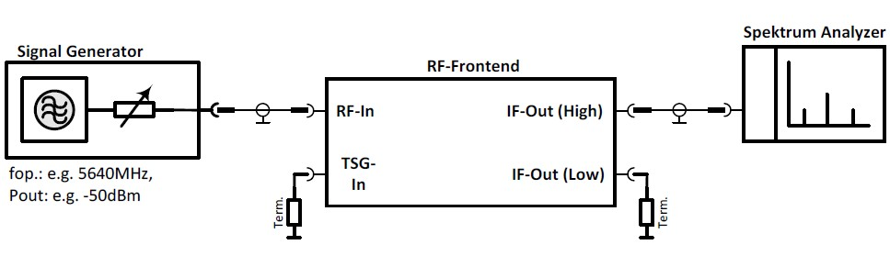
Rx Front End Gain

Slide 18
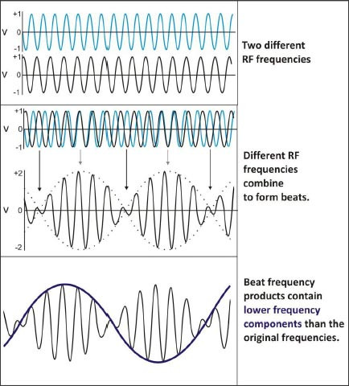
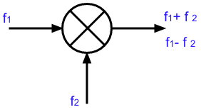
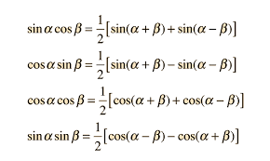
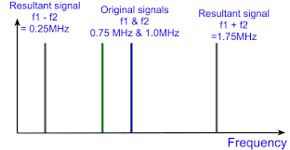
Receiver
Super heterodyne receiver are generally used in radars
heterodyne means to mix two signals of different frequencies together, resulting in a "beat" frequency
a superheterodyne receiver contains a combination of amplification with frequency mixing

Slide 19
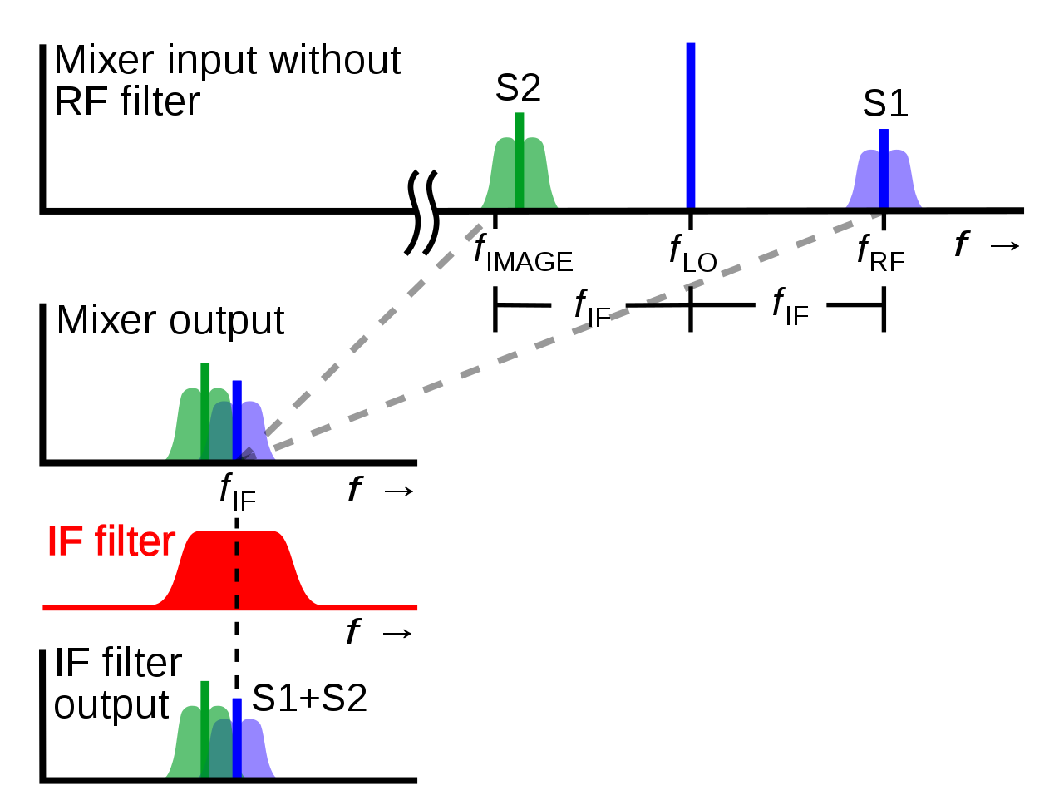
IMAGE REJECTION (IR)
FLO =110 MHz
Case 1 :
FRF=100 MHz (the wanted signal),
Fsum=210 MHz (ignored by the receiver),
Fdiff =10 MHz (IF)
Case 2:
FRF= 120 MHz (the unwanted signal),
Fsum= 230 MHz (ignored by the receiver),
Fdiff =10 MHz (IF)
The signal at 120 MHz is called the image of the wanted signal at 100 MHz.
The ability of the receiver to reject this image gives the image rejection ratio (IMRR) of the system.

Slide 20
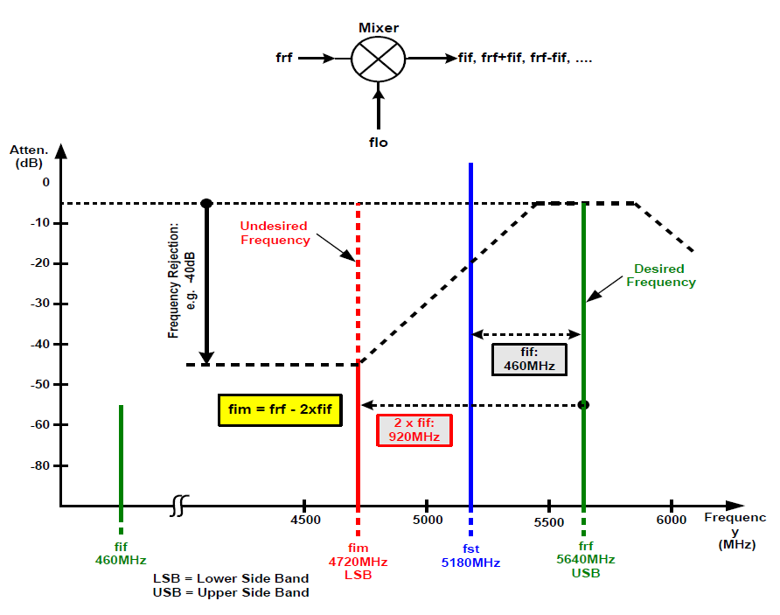
IMAGE REJECTION RATIO (IRR)
The IRR specification compares the levels of signals of equal strength on the wanted and image frequencies of a heterodyne system, quoting the level of rejection of the unwanted signal

Slide 21
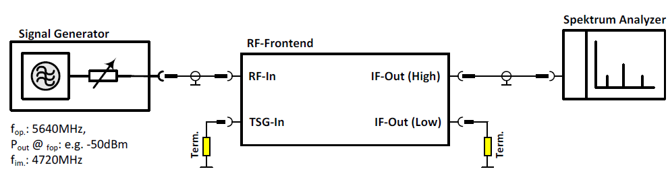
IMAGE REJECTION (IR)

Slide 22
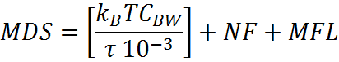
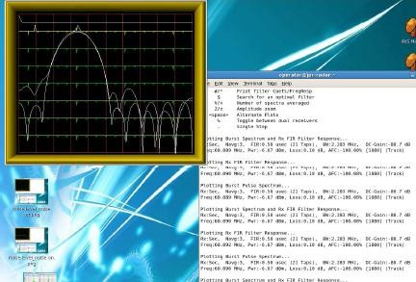
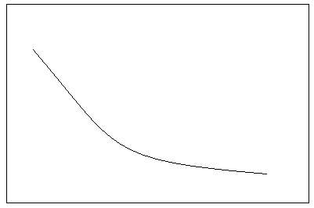
MDS
MDS= -174dBm + F (dB) + Bw (dB) + L (dB)
1.5dB
M D S
τ ---->
The minimum discernible/ detectable signal (MDS) is the minimum
signal power that can be detected above the noise level of the system.

Slide 23
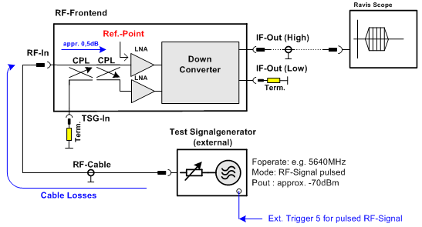
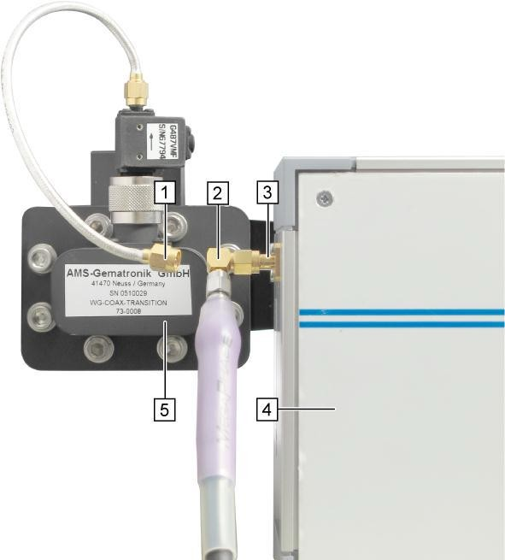
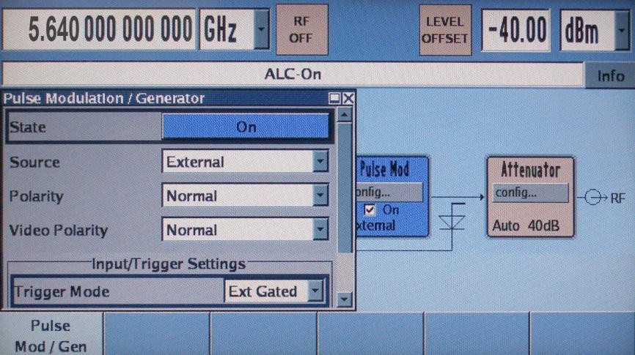
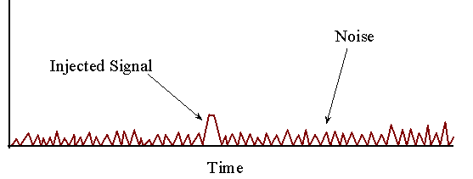
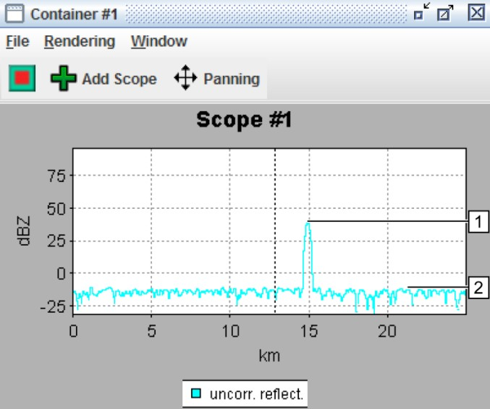
MDS Measurement

Slide 24
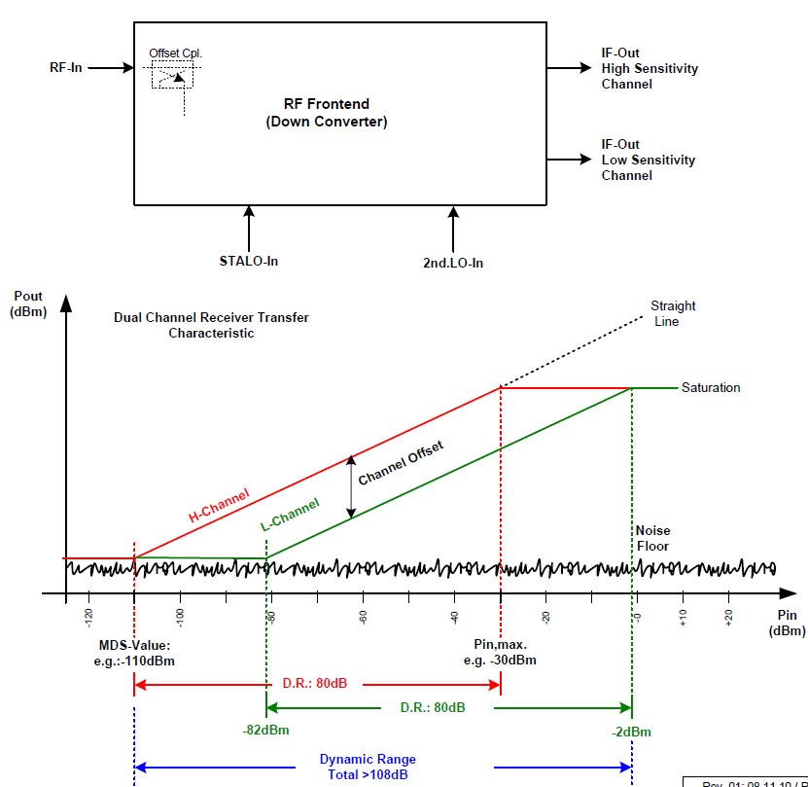
Receiver Dynamic Range

Slide 25
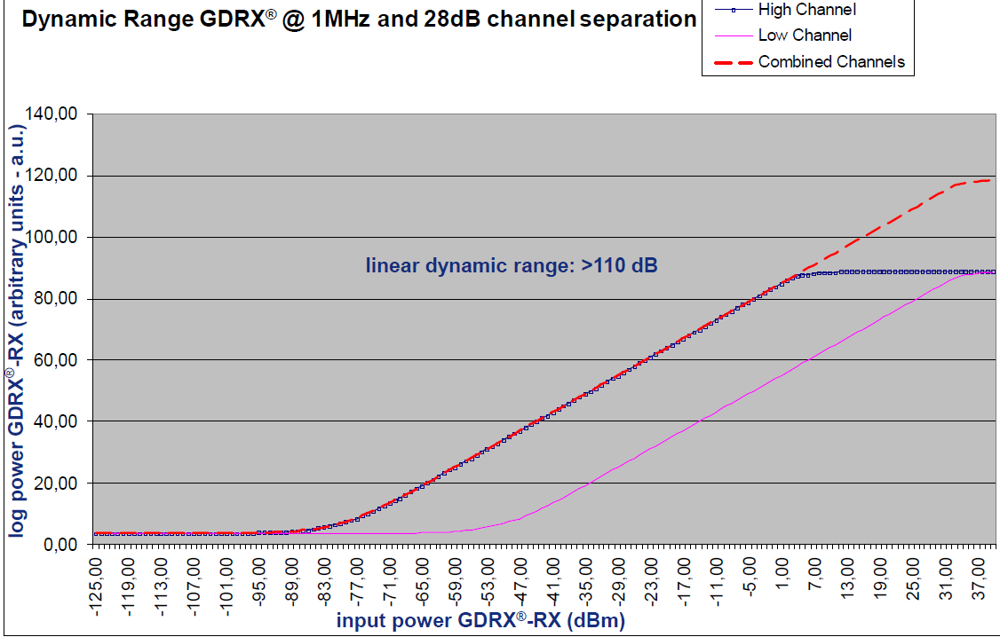
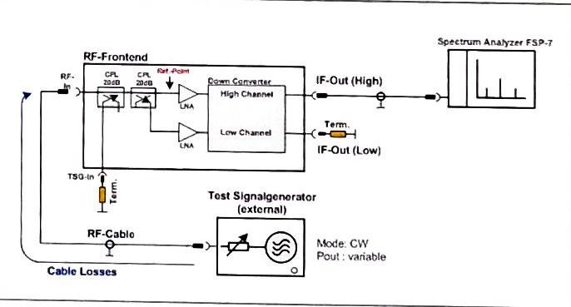
Rx Linearity (Dynamic Range)
The dynamic range of the radar system is the range of powers that can be detected.
The very weakest signals can be detected above the noise level, whereas the strongest signals (strong storms at close range) saturate the receiver.
Radar systems typically use step attenuators to lower the power return from nearby strong storms, by decreasing the return power by a known amount prior to detection by the receiver.

Slide 26
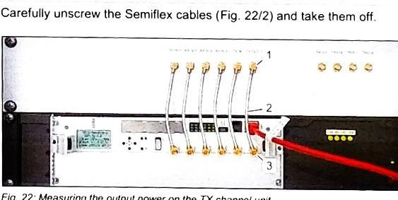
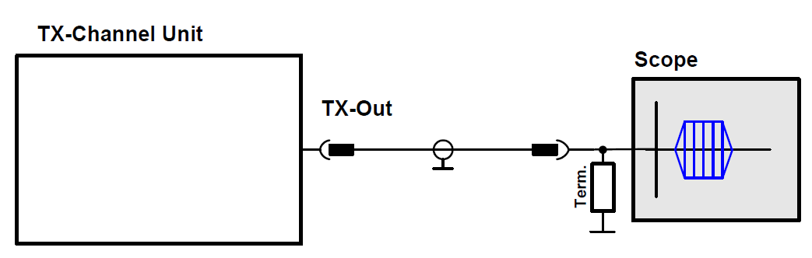
Tx Channel Freq and Power

Slide 27
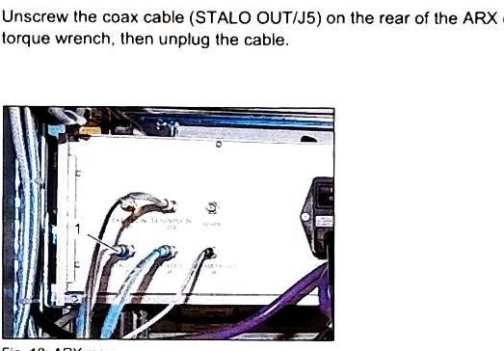
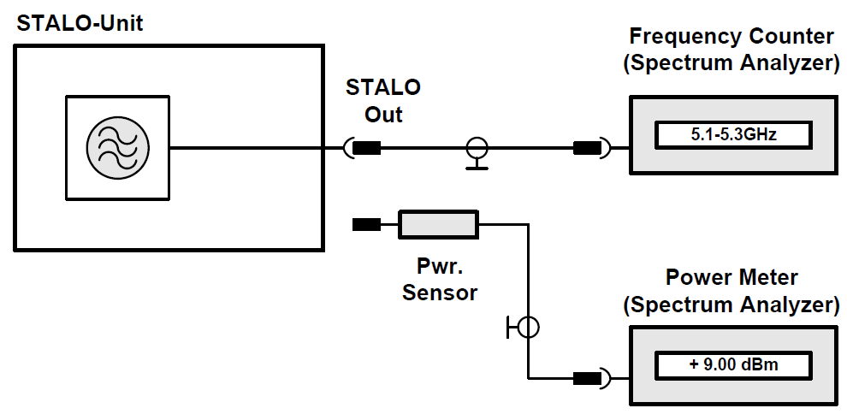
STALO Frequency & Power

Slide 28
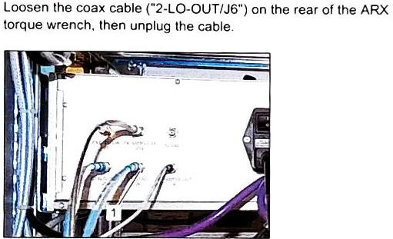
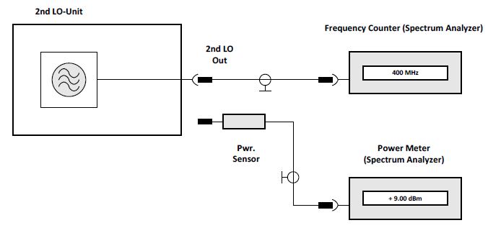
2nd LO Frequency & Power

Slide 29
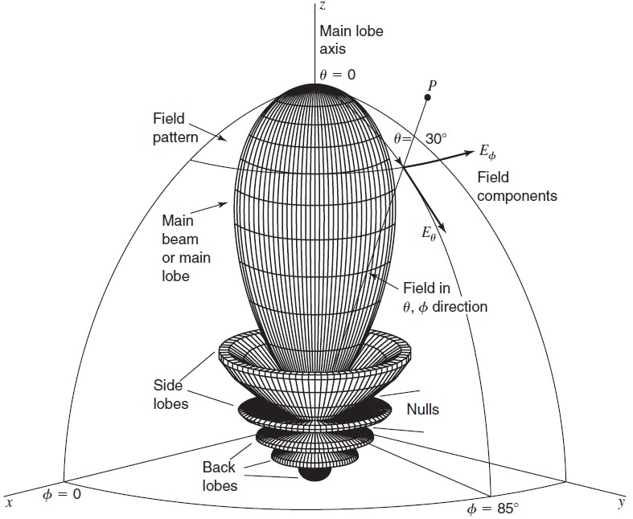
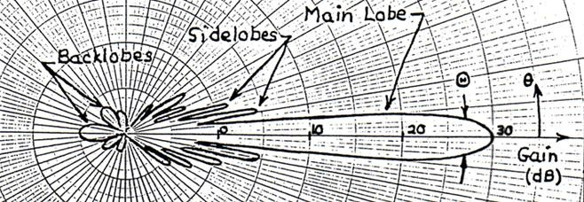
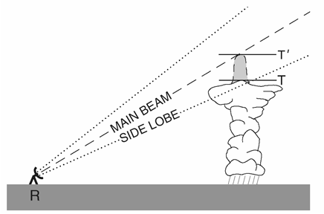
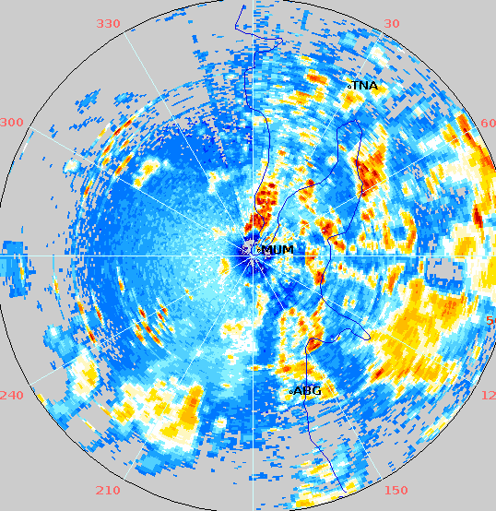
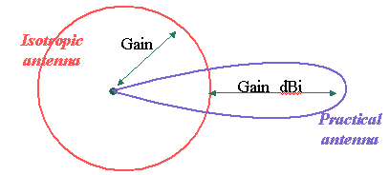
Antenna Beam Width & Gain
𝑆(𝜃) 8𝐽 [𝐷 sin 𝜃/𝜆] ²
𝑓²(𝜃) = = {
2
}
𝑆(0) [(𝐷 sin 𝜃)/𝜆]²
𝜃 = 1.27 𝜆/𝐷 or 70 λ/D
G=4πξ/θ𝞿
g=Sp/S
G= 4πξAe/ λ²

Slide 30
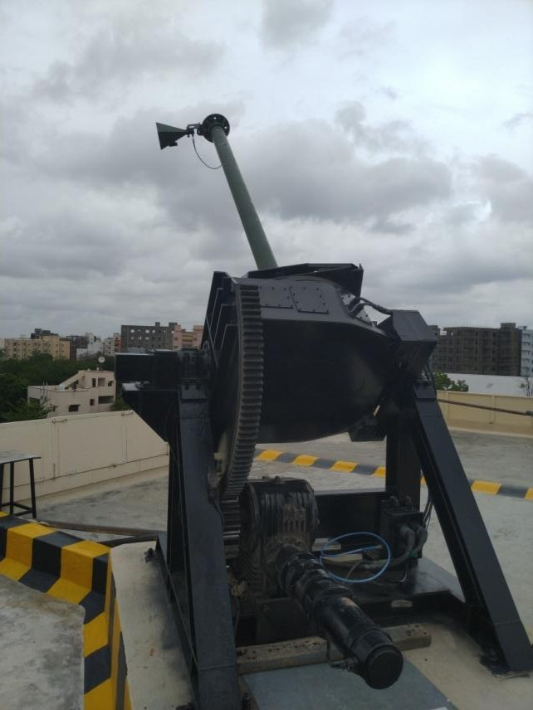
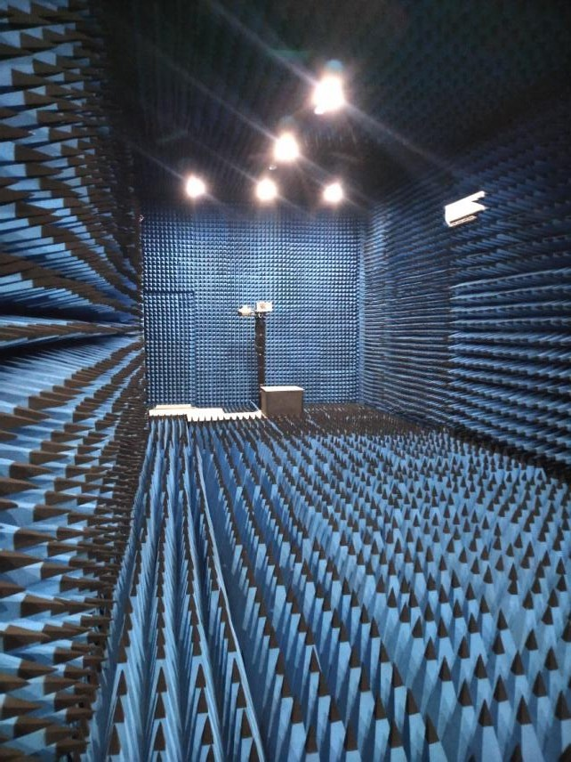
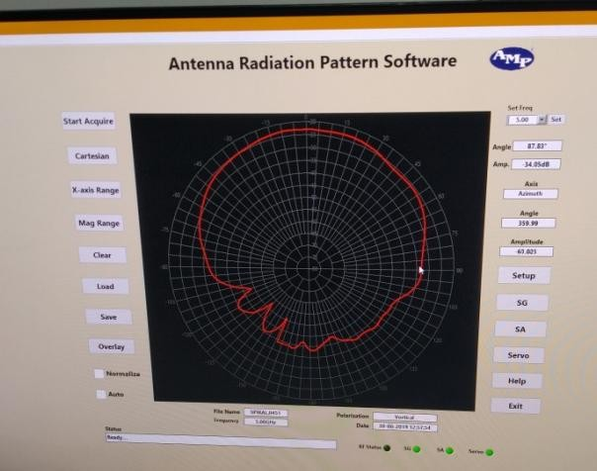

Antenna Beam Width & Gain

Slide 31

Sun Calibration
Absolute check of the weather radar calibration is through solar flux measurement of the sun, as this includes the entire gain of the radar inclusive of the antenna, also valid in finding the pointing accuracy of the Antenna/servo systems
Sun is a black body with an effective temperature of 5770 K corresponding to the peak at visible wavelength. However as to Planks law a measurable solar flux of 10-100 sfu [1sfu = 10⁻²² W/m²/Hz] is radiated at the microwave frequencies
Measurements can be obtained from the Solar Environment Center or Dominion Radio Astrophysical Observatory at Penticton, BC, Canada

Slide 32




Sun Calibration
System location and Local-Time to get position from sun track

Slide 33
Metal Sphere Calibration
Metal sphere calibration is an end-to-end, two-way reflectivity calibration, covering performance of the entire system from the transmitter to the remotely located metal sphere and back to the radar, right up to the reflectivity readout.
The procedures prescribed in the text book “Polarimetric Doppler Weather Radar: Principles and Applications” By V. N. Bringi and V. Chandrasekar (section 6.3, Radar Calibration page 334 & 335) was followed in this experiment

Slide 34

Metal Sphere Calibration ….
A Sphere of known diameter (~30cm) surface of which is quoted with metal was tied to a hydrogen filled balloon and launched into the atmosphere.

Slide 35

Metal Sphere Calibration …
Radar Cross section (RCS) of a metal sphere of known diameter > the radar wavelength is constant (equal to the geometrical cross section area. Why?) and computable.

Slide 36


Metal Sphere Calibration
Equivalent reflectivity factor (Ze) of the metal sphere can be computed using the expression
If, range =100 km, θ =Φ= 1°, D = 30 cm,
To = 1 μSec, K_{w}² = 0.93
Ze =27.42763 dBZ

Slide 37
Metal Sphere Calibration
The balloon was tracked by a tracking radar.
Co-ordinates of the sphere in space w.r.t the DWR is calculated and communicated to DWR over phone by the tracking radar at SHAR.
DWR tracked the sphere under the guidance of the tracking radar and recorded the reflectivity factor, using A-Scope (Range normalization off)
(Note that the dBZ values thus recorded are referenced to a standard range of 100 km)

Slide 38

Metal Sphere Calibration …

Slide 39
Metal Sphere Calibration
AS observed fluctuations were due to tracking error, maximum of the recorded value is taken as representative of the metal sphere RCS.
Where aIt was 29 dBZ,
s expected value was 27.43 dBZ.
Difference between the two is the error in the radar constant in use.
Here, the error was +1.57 dB and
the correction to be applied was -1.57 dB

Slide 40
Thank you

